Slide 1
Game Idea
Christopher Cenci

Slide 2
Project Description
Title pending is an adventure survival game set in the grim medieval era where the black plague is heavily present. The player must navigate from his hometown to the city in which the king called for his aid. Throughout the game, the player will go through a series of struggles and challenges as they must venture through a series of roads and towns.
Equipped with nothing but a plague doctor uniform and some supplies, the player must traverse through a series of roads that connects to each town. The player will encounter a series of puzzles, challenges or people on the roads or in town and will have choices to make on how they should interact.

Slide 3
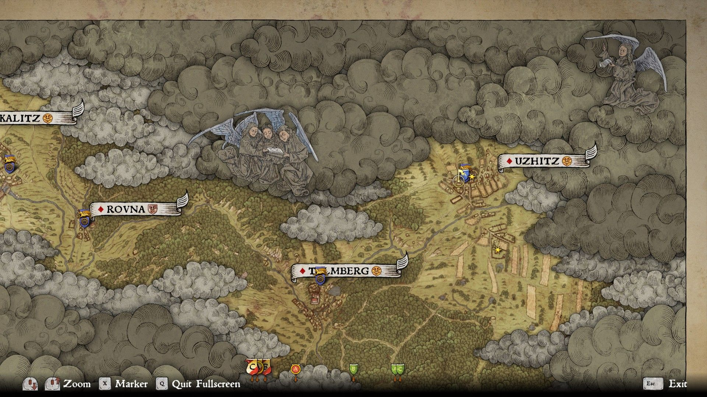
Idea/Setting/Genre/
Exploration into solving a crisis
Set in the medieval era (Europe)
Adventure/Narrative Driven/Puzzle

Slide 4
Influences
Don’t Starve
Art style
2D and not open world
Medieval History
Reflection of ideas circulating during that time
Lack of communication/misinformation
Often dark and grim
Black Plague
Focal point of the game
Experiencing challenges and meeting people related to the current situation

Slide 5
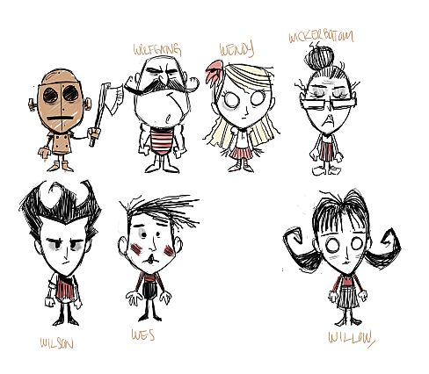
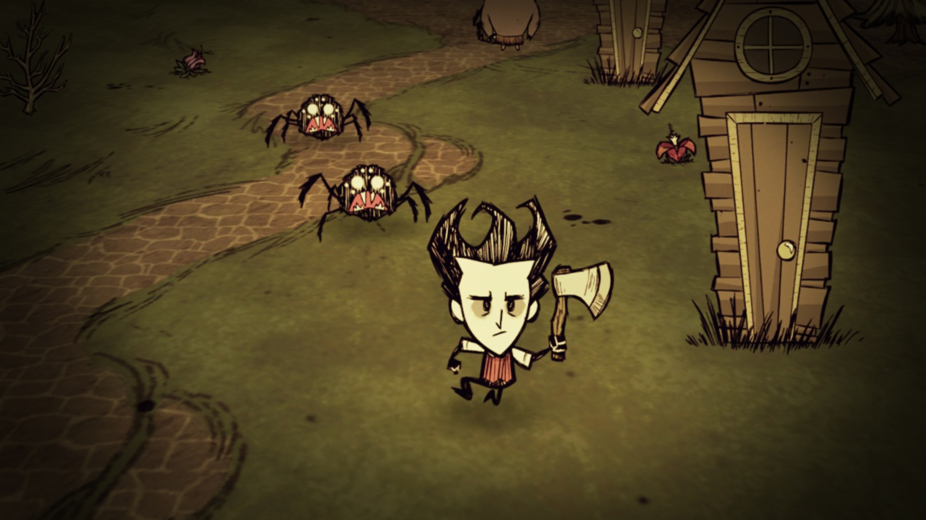
Influences

Slide 6
Story
You are a simple doctor in your town, you aid the people in your town with basic sicknesses and provide ailments to them. Your town has not yet been hit with the plague, but it has been rumored that neighboring towns have. One day a courier passes by and hands you a parcel, the king has summoned you and all other doctors in the area to meet in the city to attempt to develop a cure for the plague. The city has been struck and people are rapidly dying. Within the parcel is a plague doctor uniform and some gold. You pack up what supplies you have left and leave the morning of.

Slide 7
Gameplay Mechanics
Switching from regular clothes to plague doctor
The player will have two outfits and each outfit will change the perception on how people view them.
While being in regular clothing, the player will be seen as a neutral person, people will be less inclined to talk or aid them. When the player puts on the plague clothing, other people might look at or interact with them differently.
Dialogue choice
The player will have a series of dialogue choices and must choose the right one in order to get through certain parts, depending on the outfit the player has, the dialogue will be different.
The player will encounter people in town or on the road and will talk to him differently depending on his outfit.

Slide 8
Gameplay Mechanics (pt2)
Hiding
Sometimes its best not to engage with some people as they may be violent or have bad intent.
The player will have the option of hiding in certain areas to avoid being detected by people.
Cult Bandits
Wear a rat as their symbol, believe the plague is sent from heaven to kill sinners, they kill plague doctors on site.
Binoculars, can see what is occurring from a distance (Dialogue based)

